Slide 1


ACCIDENT SEVERITY DATA ANALYSIS
Applied Data Science Capstone Final Project

Slide 2

Predicting Accident Severity
Brief Description
Facts are that cities and major highways around the globe have recorded high rate of road fatality resulting from accident severity.
Problem Statement
The data provide an overview of the various incidents that have occurred, and factors that have influenced these incidents.
Interest
The reduction in severity of accidents can be beneficial to the Public mostly which works towards improving those road factors and the car drivers themselves who may take precaution to reduce the severity of accidents.
These accidents are majorly caused by human errors; violation of traffic rules; driving under the influence of alcohol; road and weather conditions and so on.
Accident cannot be eliminated from our roads as we commute from one place to another, but the Severity can be mitigated if all the causes are analysed and solutions are proffered.
These information include: accident severity whether it was low or high, location of the incident, severity impact, that is, whether it was an injury collision or property damage only collision, collision type, numbers of individuals involved, number of vehicles involved, road and weather conditions at the time of each incidents etc.
This project is aimed at using data science to understand the impact of each of the influences mentioned above and how to help improve on this, to advert the critical loss of lives and properties upon accident severities.

Slide 3
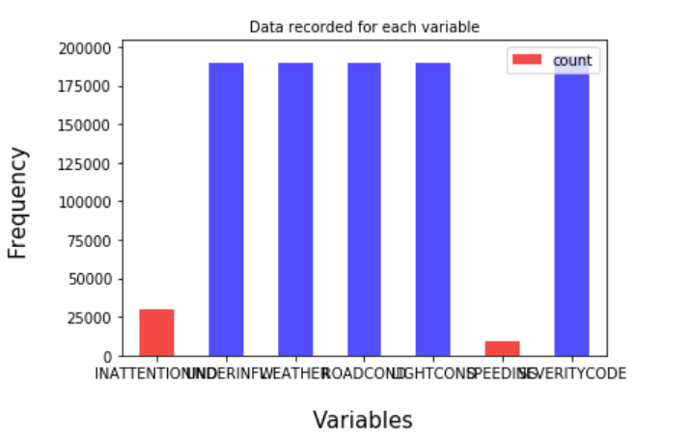
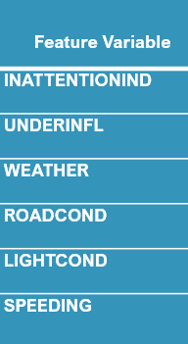
Data Preprocessing
Data Cleaning
There are a lot of problems with the data set keeping in mind that this is a machine learning project which uses classification to predict a categorical variable. The dataset has total observations of 194673 with variation in number of observations for every feature. First, the total dataset was high variation in the lengths of almost every column of the dataset. The dataset had a lot of empty columns which could have been beneficial had the data been present there.

Slide 4
Data Preprocessing
Feature Variable | Description
INATTENTIONIND | Whether or not the driver was inattentive (Y / N)
UNDERINFL | Whether or not the driver was under the influence of drinking (Y / N)
WEATHER | Weather condition during impact collision (Overcast / Rain / Clear)
ROADCOND | Road condition during impact collision (Wet / Dry / Unknown)
LIGHTCOND | Light condition during impact collision (Light On / Dark with light on)
SPEEDING | Whether the car was above the speed limit at the time of collision (Y / N)
Feature Selection
A total of six (6) features were trained while the target / label variable being Severity code.

Slide 5
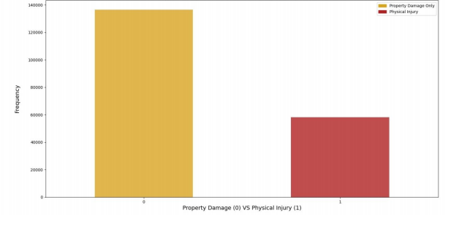
Methodology
Exploratory Data Analysis
Considering that the feature set and the target variable are categorical variables with the likes of weather, road condition and light condition being an above level 2 categorical variables whose values are limited and usually based on a particular finite group whose correlation might depict a different image then what it actually is. Generally, considering the effect of these variables in car accidents are important hence these variables were selected. A few pictorial depictions of the dataset were made in order to better understand the data.
Accident Classification based on types

Slide 6
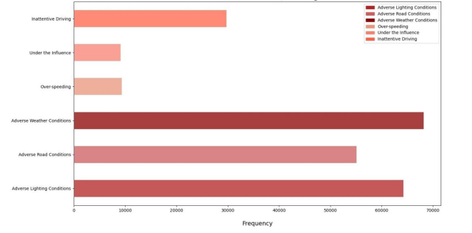
Methodology
Exploratory Data Analysis
The above figure illustrates, after data cleaning has taken place, the distribution of the target variables between Physical Injury and Property Damage Only. As the dataset is supervised but an unbalanced dataset where the distribution of the target variable is in almost 1:2 ratio in favour of property damage. It is very important to have a balanced dataset when using machine learning algorithms.
Classification of Accident Causes

Slide 7
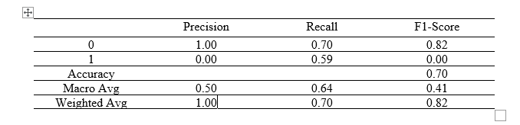
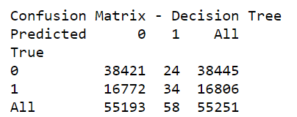
Machine Learning Model Building
Decision Tree Analysis
Decision Tree Classifier from the scikit-learn library was used to run the Decision Tree Classification model on the Car Accident Severity data. The criterion chosen for the classifier was ‘entropy’ and the max depth was ‘6’.
Classification Report
Confusion Matrix

Slide 8
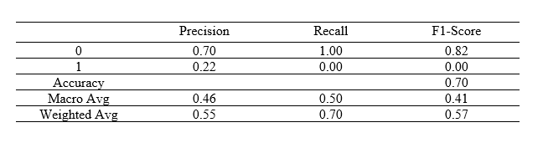

Machine Learning Model Building
Logistic Regression
Logistic Regression from the scikit-learn library was used to run the Logistic Regression Classification model on the Car Accident Severity data. The C used for regularization strength was ‘0.01’ whereas the solver used was ‘bilinear’.
Classification Report
Confusion Matrix

Slide 9
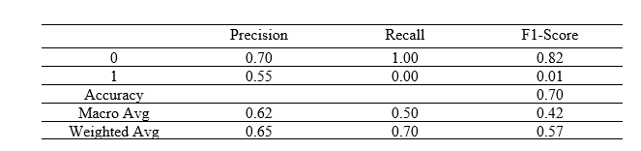

Machine Learning Model Building
Advanced Gradient Boost
The Advanced gradient boost from the gradient boost was used to run the advanced gradient boost model on the Car Accident Severity data. With random state of 20 and learning rate of about 0.1.
Classification Report
Confusion Matrix

Slide 10
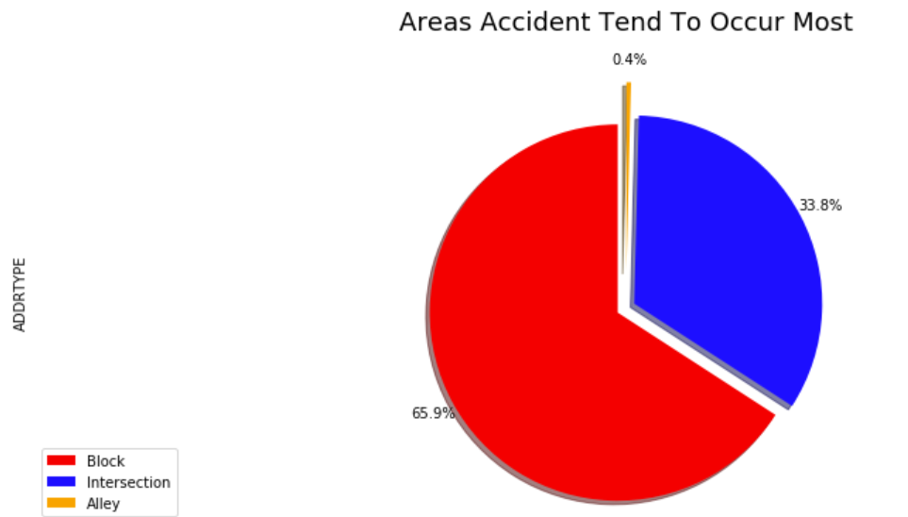
Conclusion
A balanced dataset for the target variable.
More instances recorded of all the accidents taken place
Less missing values within the dataset for variables such as Speeding and Under the influence.
More factors, such as precautionary measures taken when driving, etc. There should be a launch of developmental project in areas of severe accidents to minimize the effects of these factors. According to the diagram shown below
Areas Accident Tends To Occur Most

